Slide 1
Team Assignment 3
Team 2

Slide 2
Raw Data
11.18 | 13.94 | 14.73 | 15.41 | 16.11 | 17.3
12.51 | 14.3 | 14.96 | 15.5 | 16.48 | 17.36
12.59 | 14.37 | 15.05 | 15.61 | 16.5 | 18.06
12.85 | 14.38 | 15.14 | 15.75 | 16.63 | 18.28
13.24 | 14.45 | 15.18 | 16.04 | 17.27 | 20.78
A total of 30 data entries were recorded.

Slide 3
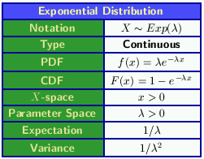
Chosen probability distribution(Exponential)
The exponential distribution is one of the widely used continuous distributions. It is often used to model the time elapsed between events. We will now mathematically define the exponential distribution, and derive its mean and expected value.

Slide 4

Chosen probability distribution(Assumptions)
The exponential distribution arises in connection with Poisson processes. A Poisson process is one exhibiting a random arrival pattern in the following sense:
1. For a small time interval Δt, the probability of an arrival during Δt is λΔt, where λ = the mean arrival rate;
2. The probability of more than one arrival during Δt is negligible
3. Interarrival times are independent of each other.
Under these assumptions, it can be shown that the pdf for the distribution of interarrival times is given by
which is the exponential distribution.

Slide 5
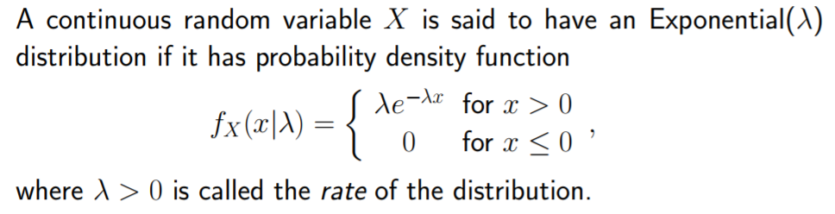
Chosen probability distribution(Parameters)
The parameter lambda is called rate parameter. A random variable having an exponential distribution is also called an exponential random variable.

Slide 6
iii)mean & Standard Deviation
One person - Mean = 15.4s
Λ = 15
1/λ = 1/15
S.D=1/15.4

Slide 7
iii.b)Probability
P( <30)
Expon dist. (30, 1/15.4, 1)
= 0.857

Slide 8
iV)
iv)let 0.7=e^(-1/15t)
In(0.7)=Ine(1/-15)
t=In(0.7) / (-1/15)
=5.35 secs
For 70% of the times, passengers will need to wait for 5.35 seconds for a taxi to arrive.

Slide 9
Conclusion
We learned that:
The exponential distribution is the only continuous distribution that is "memoryless"
The evident utility of the exponential distribution in discrete systems simulation is its effectiveness for modeling the random arrival pattern represented in a Poisson process.

Slide 10
Thank You! :)

